Slide 1
Boundless Lecture Slides
Available on the Boundless Teaching Platform
Free to share, print, make copies and changes. Get yours at www.boundless.com

Slide 2
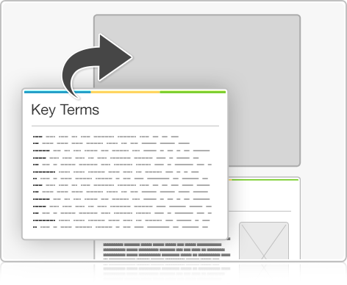
Using Boundless Presentations
Boundless Teaching Platform
Boundless empowers educators to engage their students with affordable, customizable textbooks and intuitive teaching tools. The free Boundless Teaching Platform gives educators the ability to customize textbooks in more than 20 subjects that align to hundreds of popular titles. Get started by using high quality Boundless books, or make switching to our platform easier by building from Boundless content pre-organized to match the assigned textbook. This platform gives educators the tools they need to assign readings and assessments, monitor student activity, and lead their classes with pre-made teaching resources.
Get started now at:
The Appendix
The appendix is for you to use to add depth and breadth to your lectures. You can simply drag and drop slides from the appendix into the main presentation to make for a richer lecture experience.
http://boundless.com/teaching-platform
Free to edit, share, and copy
Feel free to edit, share, and make as many copies of the Boundless presentations as you like. We encourage you to take these presentations and make them your own.
If you have any questions or problems please email:
educators@boundless.com
Free to share, print, make copies and changes. Get yours at www.boundless.com

Slide 3
About Boundless
Boundless is an innovative technology company making education more affordable and accessible for students everywhere. The company creates the world’s best open educational content in 20+ subjects that align to more than 1,000 popular college textbooks. Boundless integrates learning technology into all its premium books to help students study more efficiently at a fraction of the cost of traditional textbooks. The company also empowers educators to engage their students more effectively through customizable books and intuitive teaching tools as part of the Boundless Teaching Platform. More than 2 million learners access Boundless free and premium content each month across the company’s wide distribution platforms, including its website, iOS apps, Kindle books, and iBooks. To get started learning or teaching with Boundless, visit boundless.com.
Free to share, print, make copies and changes. Get yours at www.boundless.com

Slide 4
Oxidative Phosphorylation
Cellular Respiration > Oxidative Phosphorylation
Electron Transport Chain
Chemiosmosis and Oxidative Phosphorylation
ATP Yield
Free to share, print, make copies and changes. Get yours at www.boundless.com
www.www/boundless.com/biology?campaign_content=book_1514_section_76&campaign_term=Biology&utm_campaign=powerpoint&utm_medium=direct&utm_source=boundless

Slide 5
Appendix
Free to share, print, make copies and changes. Get yours at www.boundless.com

Slide 6
Key terms
Cellular Respiration
ATP synthase ATP synthase is an important enzyme that provides energy for the cell to use through the synthesis of adenosine triphosphate (ATP).
catabolism Destructive metabolism, usually including the release of energy and breakdown of materials.
chemiosmosis The movement of ions across a selectively permeable membrane, down their electrochemical gradient.
complex A structure consisting of a central atom, molecule, or protein weakly connected to surrounding atoms, molecules, or proteins.
oxidative phosphorylation Oxidative phosphorylation (or OXPHOS in short) is a metabolic pathway that uses energy released by the oxidation of nutrients to produce adenosine triphosphate (ATP).
prosthetic group The non-protein component of a conjugated protein.
ubiquinone A lipid soluble substance that is a component of the electron transport chain and accepts electrons from complexes I and II.
Free to share, print, make copies and changes. Get yours at www.boundless.com

Slide 7
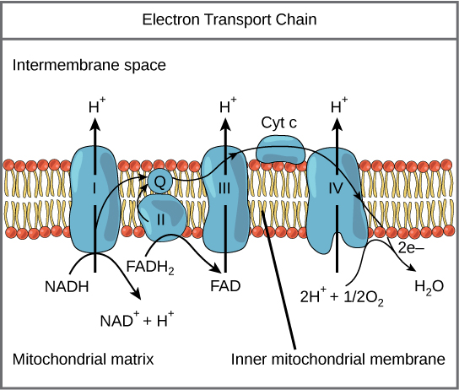
Cellular Respiration
The electron transport chain
The electron transport chain is a series of electron transporters embedded in the inner mitochondrial membrane that shuttles electrons from NADH and FADH2 to molecular oxygen. In the process, protons are pumped from the mitochondrial matrix to the intermembrane space, and oxygen is reduced to form water.
Free to share, print, make copies and changes. Get yours at www.boundless.com
OpenStax CNX. "OpenStax College, Oxidative Phosphorylation. October 16, 2013." CC BY 3.0 http://cnx.org/content/m44437/latest/Figure_07_04_01.jpg View on Boundless.com

Slide 8
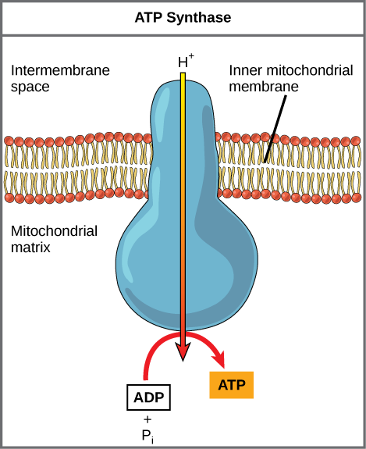
Cellular Respiration
ATP Synthase
ATP synthase is a complex, molecular machine that uses a proton (H+) gradient to form ATP from ADP and inorganic phosphate (Pi).
Free to share, print, make copies and changes. Get yours at www.boundless.com
OpenStax CNX. "OpenStax College, Oxidative Phosphorylation. October 16, 2013." CC BY 3.0 http://cnx.org/content/m44437/latest/Figure_07_04_02.png View on Boundless.com

Slide 9
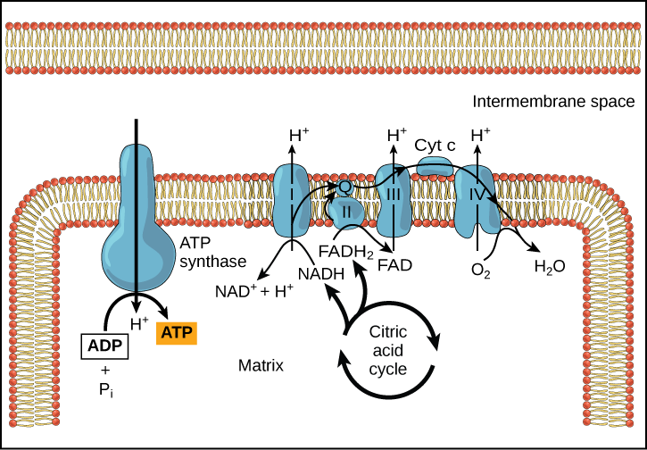
Cellular Respiration
Chemiosmosis
In oxidative phosphorylation, the hydrogen ion gradient formed by the electron transport chain is used by ATP synthase to form ATP.
Free to share, print, make copies and changes. Get yours at www.boundless.com
OpenStax CNX. "OpenStax College, Oxidative Phosphorylation. October 16, 2013." CC BY 3.0 http://cnx.org/content/m44437/latest/Figure_07_04_03.png View on Boundless.com

Slide 10
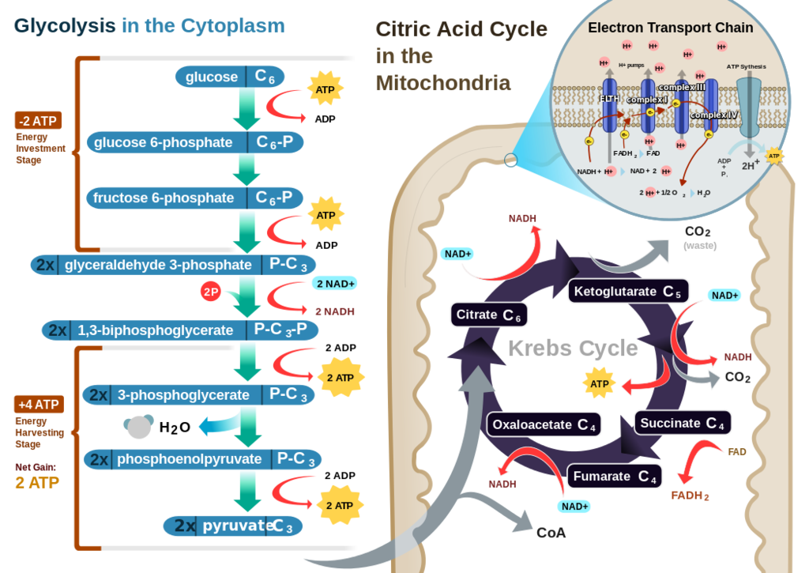
Cellular Respiration
Cellular respiration in a eukaryotic cell
Glycolysis on the left portion of this illustration can be seen to yield 2 ATP molecules, while the Electron Transport Chain portion at the upper right will yield the remaining 30-32 ATP molecules under the presence of oxygen.
Free to share, print, make copies and changes. Get yours at www.boundless.com
Wikipedia. "Cellular Respiration in a Eukaryotic Cell." CC BY-SA 3.0 https://en.wikipedia.org/wiki/Cellular_respiration#mediaviewer/File:CellRespiration.svg View on Boundless.com

Slide 11
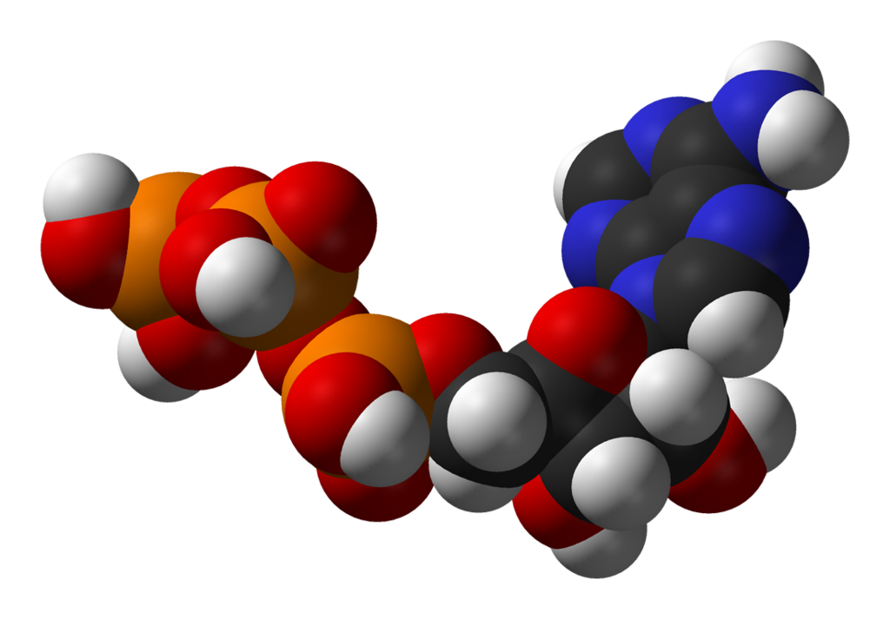
Cellular Respiration
Adenosine triphosphate
ATP is the main source of energy in many living organisms.
Free to share, print, make copies and changes. Get yours at www.boundless.com
Wikipedia. "ATP-3D-vdW." Public domain http://en.wikipedia.org/wiki/File:ATP-3D-vdW.png View on Boundless.com

Slide 12
Cellular Respiration
Which of the following statements accurately describes the flow of electrons through the electron transport chain, as well as their eventual destination?
A) Electrons come from NAD+ and FAD+ and eventually go to water.
B) Electrons come from NAD+ and FAD+ and eventually go to oxygen.
C) Electrons come from NADH and FADH2 and eventually go to water.
D) Electrons come from NADH and FADH2 and eventually go to oxygen.
Free to share, print, make copies and changes. Get yours at www.boundless.com

Slide 13
Cellular Respiration
Which of the following statements accurately describes the flow of electrons through the electron transport chain, as well as their eventual destination?
A) Electrons come from NAD+ and FAD+ and eventually go to water.
B) Electrons come from NAD+ and FAD+ and eventually go to oxygen.
C) Electrons come from NADH and FADH2 and eventually go to water.
D) Electrons come from NADH and FADH2 and eventually go to oxygen.
Free to share, print, make copies and changes. Get yours at www.boundless.com
Boundless - LO. "Boundless." CC BY-SA 3.0 http://www.boundless.com/

Slide 14
Cellular Respiration
How do hydrogen ions aid in the synthesis of ATP?
A) Hydrogen ions add a phosphate to ATP synthase to form ATP.
B) ATP synthase uses a hydrogen ion gradient to form ATP from ADP
C) Hydrogen ions add protons to ADP to form ATP.
D) Hydrogen ions add protons to ATP synthase to form ATP.
Free to share, print, make copies and changes. Get yours at www.boundless.com

Slide 15
Cellular Respiration
How do hydrogen ions aid in the synthesis of ATP?
A) Hydrogen ions add a phosphate to ATP synthase to form ATP.
B) ATP synthase uses a hydrogen ion gradient to form ATP from ADP
C) Hydrogen ions add protons to ADP to form ATP.
D) Hydrogen ions add protons to ATP synthase to form ATP.
Free to share, print, make copies and changes. Get yours at www.boundless.com
Boundless - LO. "Boundless." CC BY-SA 3.0 http://www.boundless.com/

Slide 16
Cellular Respiration
Which of the following are sources of variability in the amount of ATP equivalents produced per molecule of glucose consumed?
A) The electron carrier, either NAD+ or FAD+, will produce different amounts of ATP.
B) The number of hydrogen ions the electron transport chains pumps is the same in all species.
C) all of these answers
D) In some species, lipids block the catabolism of glucose molecules.
Free to share, print, make copies and changes. Get yours at www.boundless.com

Slide 17
Cellular Respiration
Which of the following are sources of variability in the amount of ATP equivalents produced per molecule of glucose consumed?
A) The electron carrier, either NAD+ or FAD+, will produce different amounts of ATP.
B) The number of hydrogen ions the electron transport chains pumps is the same in all species.
C) all of these answers
D) In some species, lipids block the catabolism of glucose molecules.
Free to share, print, make copies and changes. Get yours at www.boundless.com
Boundless - LO. "Boundless." CC BY-SA 3.0 http://www.boundless.com/

Slide 18
Attribution
Cellular Respiration
OpenStax CNX. "OpenStax College, Biology. October 16, 2013." CC BY 3.0 http://cnx.org/content/m44437/latest/?collection=col11448/latest
Wikipedia. "Oxidative phosphorylation." CC BY-SA 3.0 https://en.wikipedia.org/wiki/Oxidative_phosphorylation
Wikipedia. "ubiquinone." CC BY-SA 3.0 http://en.wikipedia.org/wiki/ubiquinone
Wiktionary. "prosthetic group." CC BY-SA 3.0 http://en.wiktionary.org/wiki/prosthetic+group
Wiktionary. "complex." CC BY-SA 3.0 http://en.wiktionary.org/wiki/complex
OpenStax CNX. "OpenStax College, Biology. October 16, 2013." CC BY 3.0 http://cnx.org/content/m44437/latest/?collection=col11448/latest
Wikipedia. "ATP synthase." CC BY-SA 3.0 http://en.wikipedia.org/wiki/ATP%20synthase
Wikipedia. "oxidative phosphorylation." CC BY-SA 3.0 http://en.wikipedia.org/wiki/oxidative%20phosphorylation
Wikipedia. "chemiosmosis." CC BY-SA 3.0 http://en.wikipedia.org/wiki/chemiosmosis
OpenStax CNX. "OpenStax College, Biology. October 16, 2013." CC BY 3.0 http://cnx.org/content/m44437/latest/?collection=col11448/latest
Wiktionary. "catabolism." CC BY-SA 3.0 http://en.wiktionary.org/wiki/catabolism
Free to share, print, make copies and changes. Get yours at www.boundless.com

